Slide 1
Engineering Component Update
Clarence Toh

Slide 2
Blockchain prototype
Next Update: 14-08-2020
Objective
Build a workable blockchain prototype
Select blockchain framework 60% completed
Set up AWS blockchain cluster 0% completed
Test blockchain solution 0% completed
Software Dependencies
<Python 3.8? Ubuntu 18.xx? Django?>
<specific library and version>
Expected Features
1. Available as a scalable plug-in / library that can be imported as a dependency for existing commercial project
2. Set of well-documented APIs callable over Cloud / IoT / Mobile
3. <TBC as per discussion>
Sample Use Cases
1. Plug in can be used to track financial transactions.
2. Plug in can be used to keep track of assets or goods deliveries.
3.
DxC Github URL: https://github.dxc.com//ctoh8/blockchain-prototype

Slide 3

Introduction
Ever since the success of bitcoin, awareness of blockchain technology has entered public consciousness.
What is blockchain, and how can we capitalize on this technology to implement solutions DXC can market to customers is the focus of this presentation.

Slide 4
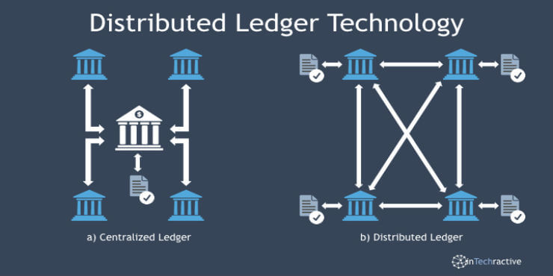
What is blockchain?
A blockchain is a distributed ledger that records all the transactions that take place on the network.
When transactions are made, they are broadcasted to all nodes in the network, which in turn record them into blocks. The blocks are appended to the end of the ledger, which is a chain of previous blocks.
As such, blockchain is sometimes called Distributed Ledger Technology (DLT).
Notes:
I will be taking an ownership as a Point of contact to for Data Pillar (2 products/reusable frameworks) with the DXC delivery folks and Outside region markets.

Slide 5
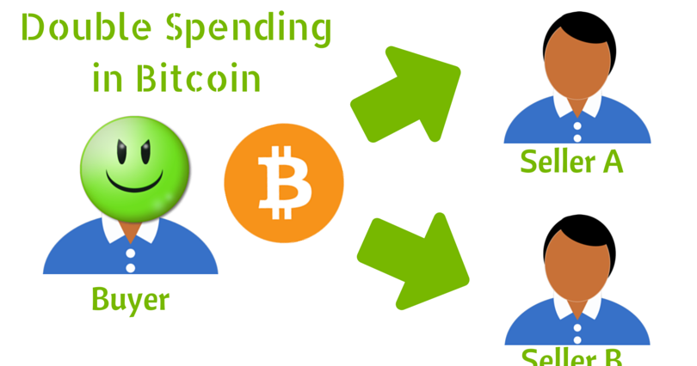
Why blockchain?
Blockchains attempt to solve two problems in digital transactions:
Digital transactions, unlike physical transactions can be duplicated, because no physical object changes hands. This is known as Double Spending.
The need for a trusted central authority to verify that transactions are unique. For instance, banks are this authority when you make internet funds transfers.
Notes:
I will be taking an ownership as a Point of contact to for Data Pillar (2 products/reusable frameworks) with the DXC delivery folks and Outside region markets.

Slide 6
How does blockchain work?
The process of extending the blockchain is often known as mining. This is because many blockchains require significant computing power to be expended to outside of recording transactions to write a block. This expended effort is known as proof of work.
Transaction broadcasted to nodes in the network
Node verifies that the transaction is unique
Multiple transactions are recorded into a block
Block is hashed and appended to the chain
The block is broadcasted to all other nodes
A hash is a function that converts an input of letters and numbers into an encrypted output of a fixed length. It is created using an algorithm and is essential to blockchain management.
Notes:
I will be taking an ownership as a Point of contact to for Data Pillar (2 products/reusable frameworks) with the DXC delivery folks and Outside region markets.

Slide 7
FAQ
How does blockchain ensure that it cannot be tampered with?
Included in every block in the blockchain is the hash of the previous block, as well as a timestamp. Blocks cannot be removed from the middle of the chain without causing the hashcheck to fail.
What if two nodes broadcast blocks at the same time?
The two chains will exist until one becomes longer than the other. The shorter chain is purged and its transactions freed up to become parts of new blocks.
Why were blockchains sometimes called “unhackable”?
Blockchains boasted of being unhackable because one needed to write blocks faster than the rest of the network to get them to accept a fake blockchain. To do this, one must have more computing power than the rest of the network, which was considered impractical in large networks. Such an attack is known as a 51% attack.
Notes:
I will be taking an ownership as a Point of contact to for Data Pillar (2 products/reusable frameworks) with the DXC delivery folks and Outside region markets.

Slide 8


Technologies
Etherum | Hyperledger
Transparent transactions | Confidential transactions
Public network | Permissioned private network
Proof of work required | Proof of work optional
~20 transactions per second | >2000 transactions per second
Notes:
I will be taking an ownership as a Point of contact to for Data Pillar (2 products/reusable frameworks) with the DXC delivery folks and Outside region markets.

